Slide 1

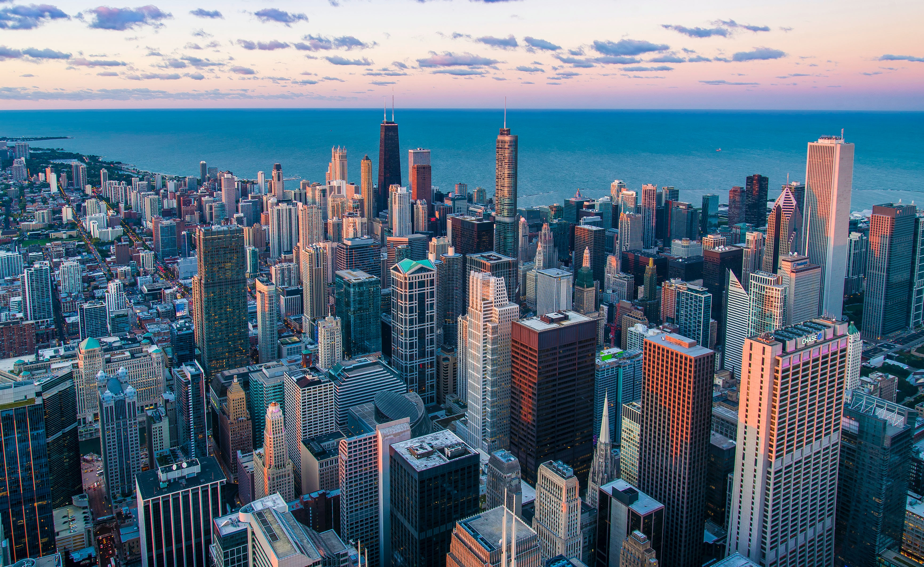
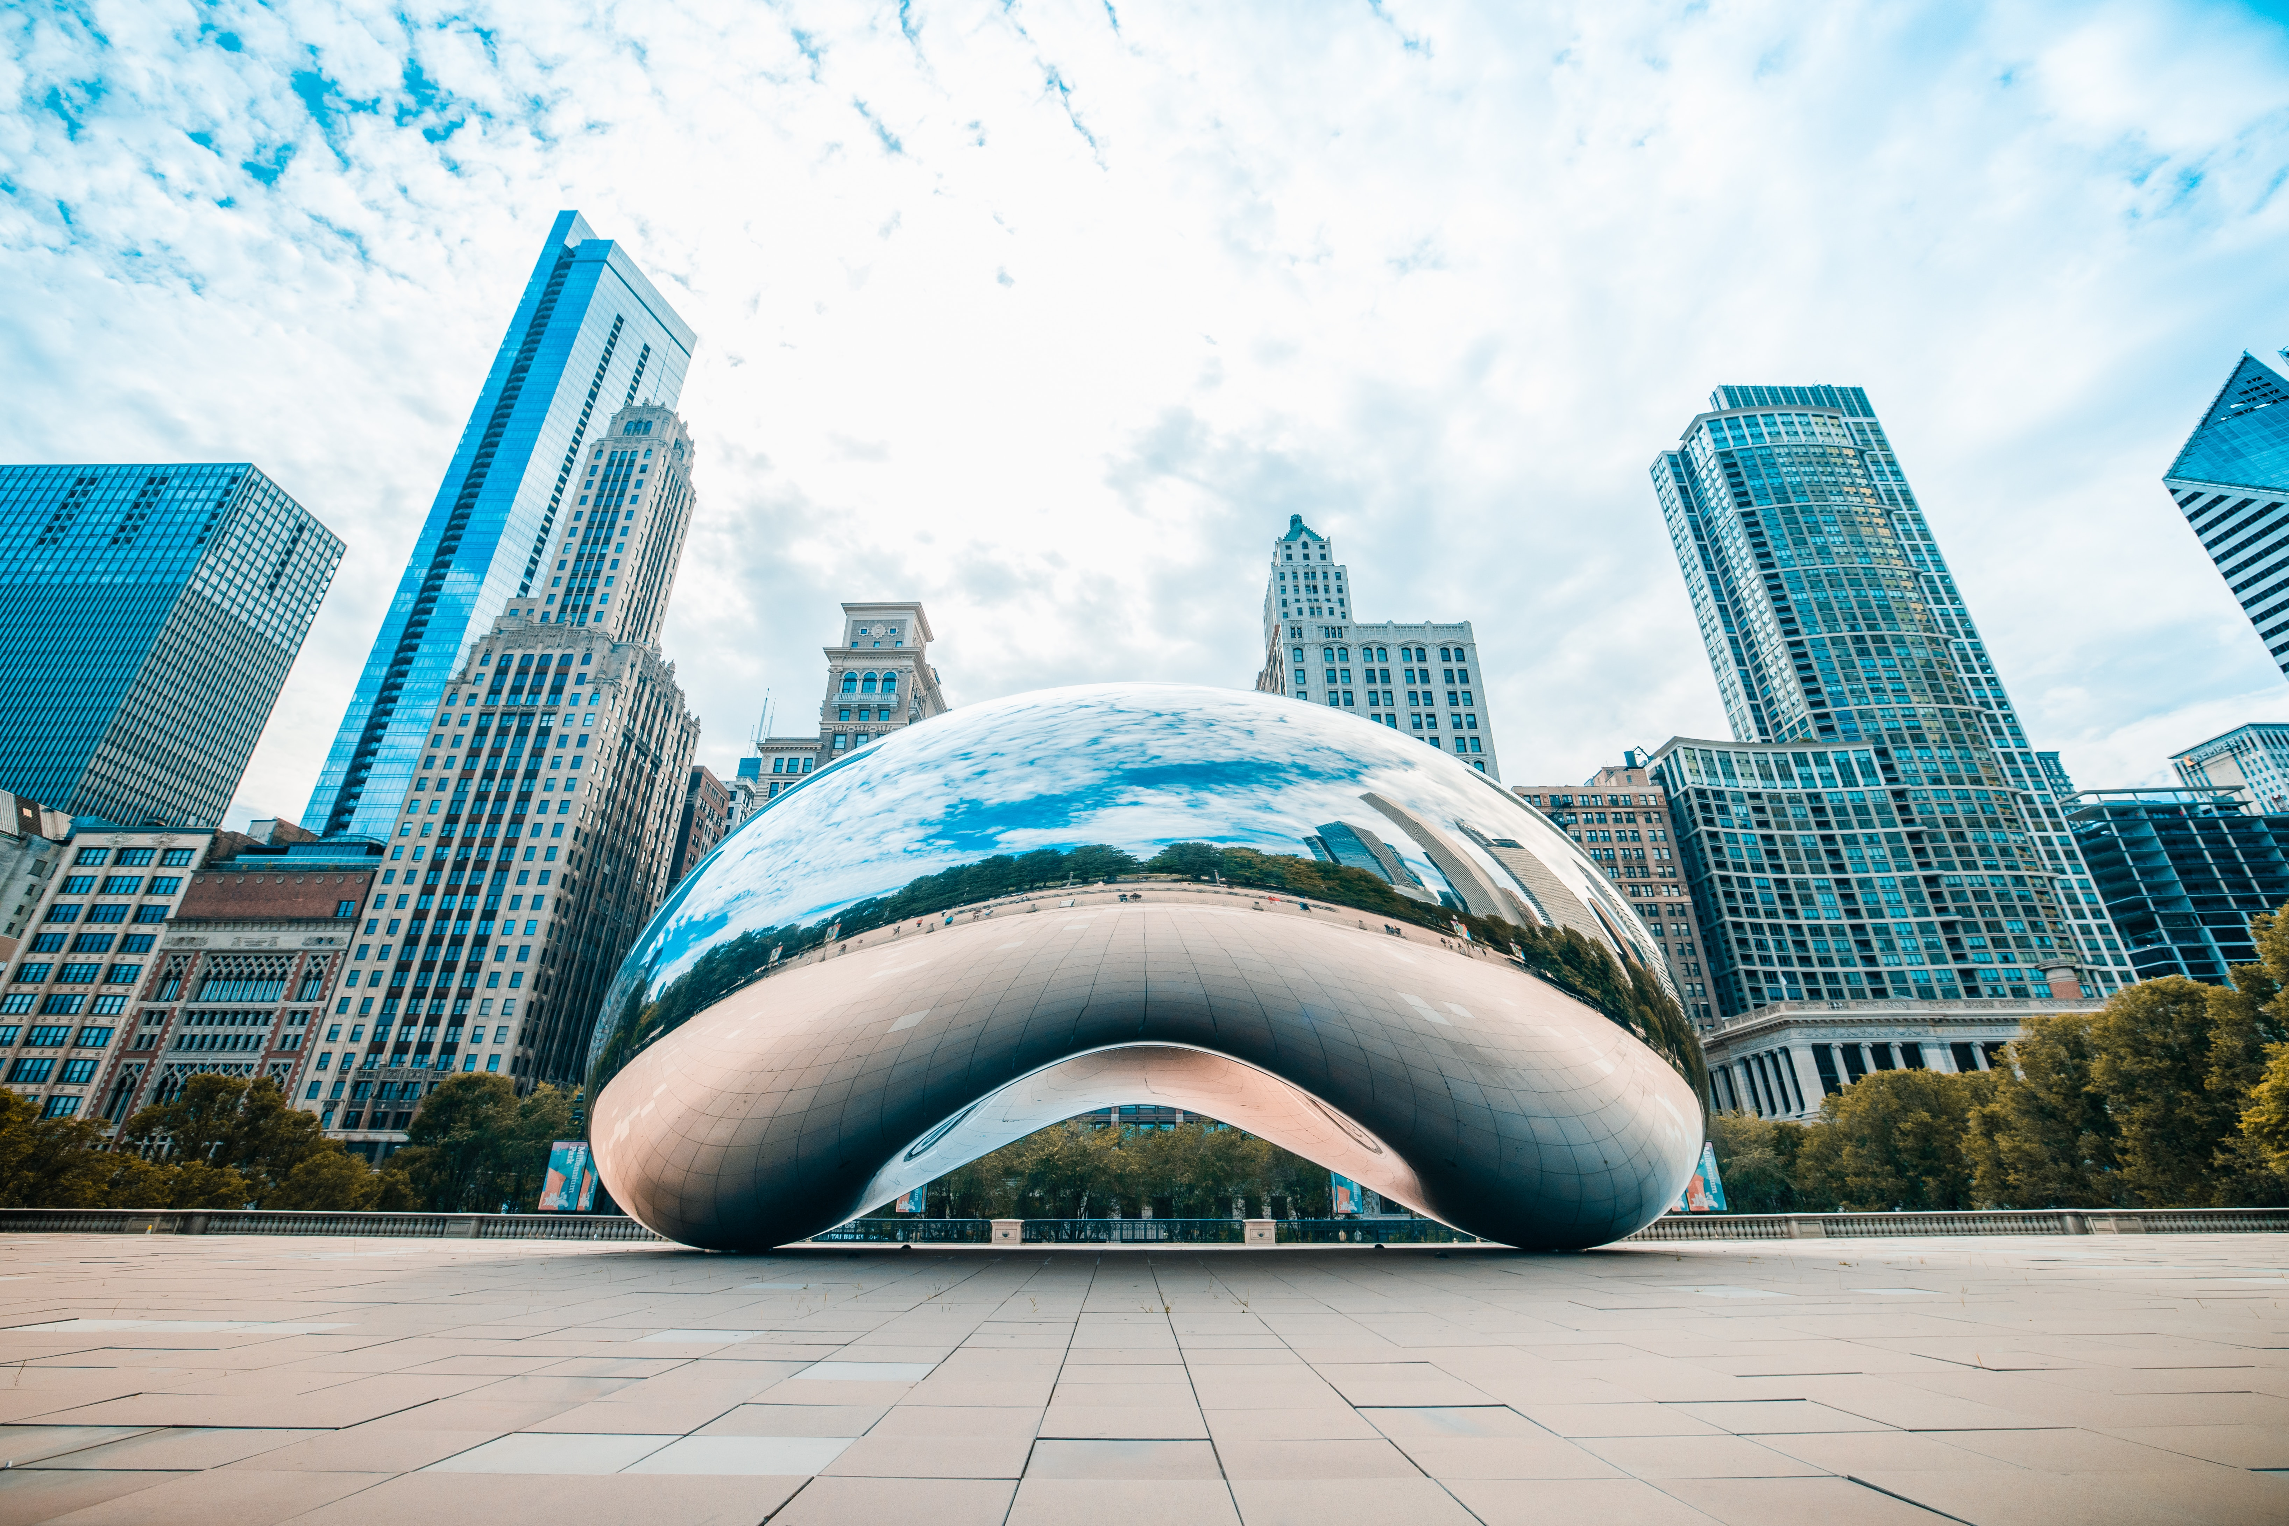
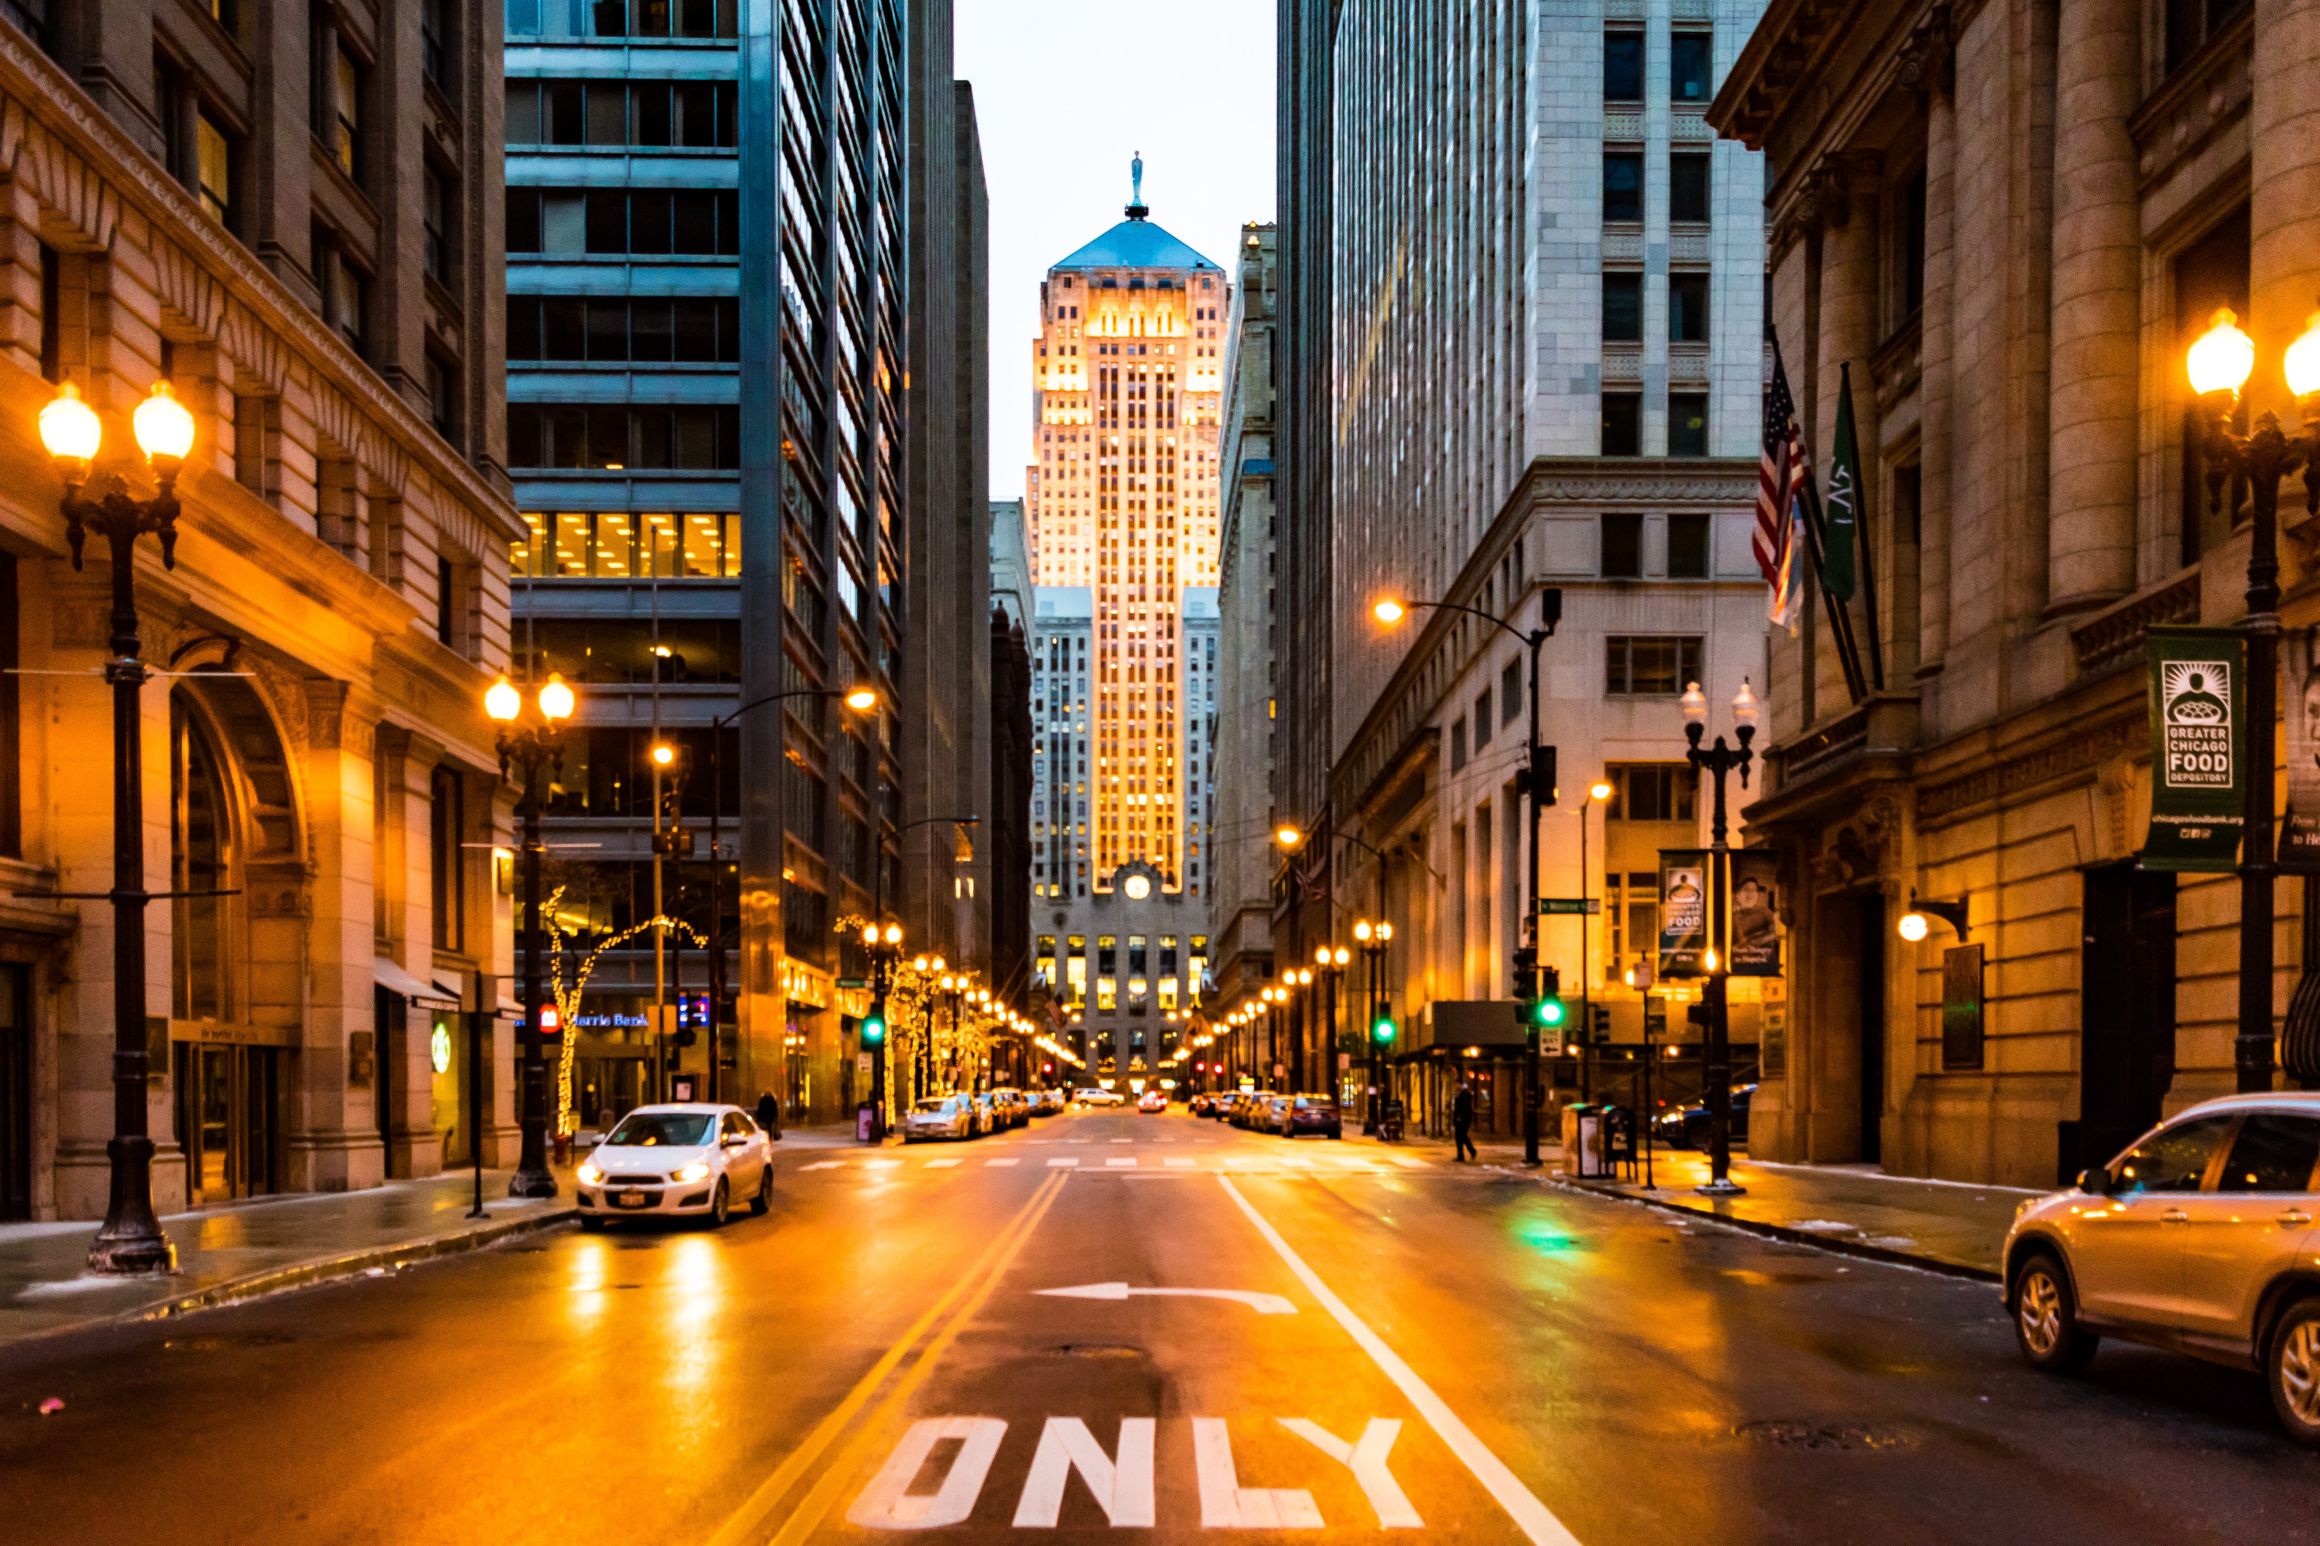
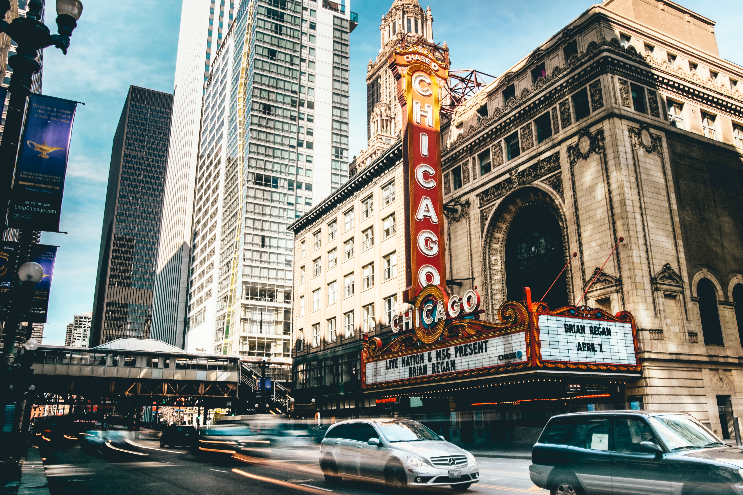

Chicago
Seattle
Los angles
Huston
New York
C
Chicago
Weather
Currently : 75 ° Hi: 78 ° / low: 58 °
Humidity: 87%
Chicago
Seattle
Los angles
Huston
New York
Chicago
Weather
Currently : 75 °
Hi: 78 ° / low: 58 °
Humidity: 87%
Chicago is known as the "Windy City," but it doesn't actually have the windiest weather in the United States. The nickname originated in the late 19th century as a metaphorical reference to the city's long-winded politicians rather than its weather patterns.
Chicago is known as the "Windy City," but it doesn't actually have the windiest weather in the United States. The nickname originated in the late 19th century as a metaphorical reference to the city's long-winded politicians rather than its weather patterns.
The Chicago River is famous for being dyed green every year on St. Patrick's Day. The tradition began in 1962 when city officials accidentally poured 100 pounds of green dye into the river. Today, they use an eco-friendly vegetable dye to turn the river a vibrant green color.

Slide 2
sawyer-bengtson--csZbF1o5_k-unsplash.jpg
Chicago
Seattle
Los angles
Huston
New York
Chicago
Chicago is known as the "Windy City," but it doesn't actually have the windiest weather in the United States. The nickname originated in the late 19th century as a metaphorical reference to the city's long-winded politicians rather than its weather patterns.
The Chicago River is famous for being dyed green every year on St. Patrick's Day. The tradition began in 1962 when city officials accidentally poured 100 pounds of green dye into the river. Today, they use an eco-friendly vegetable dye to turn the river a vibrant green color.
Chicago is home to the first-ever skyscraper. The Home Insurance Building, completed in 1885, was the first tall building to use a steel frame, allowing it to reach a height of 138 feet. While it was demolished in 1931, its innovative design paved the way for the modern skyscrapers that define Chicago's skyline today.
The iconic deep-dish pizza was invented in Chicago. In the 1940s, Pizzeria Uno and Pizzeria Due developed the deep-dish style, characterized by its thick, buttery crust, generous cheese layer, and chunky tomato sauce on top. It has since become a beloved staple of Chicago's culinary scene.
Chicago is home to one of the largest and most diverse collections of Impressionist and Post-Impressionist art outside of France. The Art Institute of Chicago houses renowned works by artists such as Claude Monet, Georges Seurat, Vincent van Gogh, and Pierre-Auguste Renoir, making it a must-visit destination for art enthusiasts.
Weather
Currently : 75 °
Hi: 78 ° / low: 58 °
Humidity: 87%

